Slide 1
Optimizing Apache Spark
The Five Most Common Performance Problems
Shuffle Mitigation:
Bucketing

Slide 2
The 5 Most Common Performance Problems (The 5 Ss)
Shuffle - Bucketing
The goal is to eliminate the exchange & sort by pre-shuffling the data
The data is aggregated into N buckets and optionally sorted [locally]
The result is then saved to a table and available for subsequent reads
But bucketing is hard to get right and a rather expensive operation
The bucketing operation pays for itself if the two tables are regularly joined and/or not reduced with some sort of filter
We will cover the benefits of bucketing real quick, but how to bucket data is a whole other conversation.
Notes:
Skew: partition-by, bucket by a second column, salt the bucketing column

Slide 3
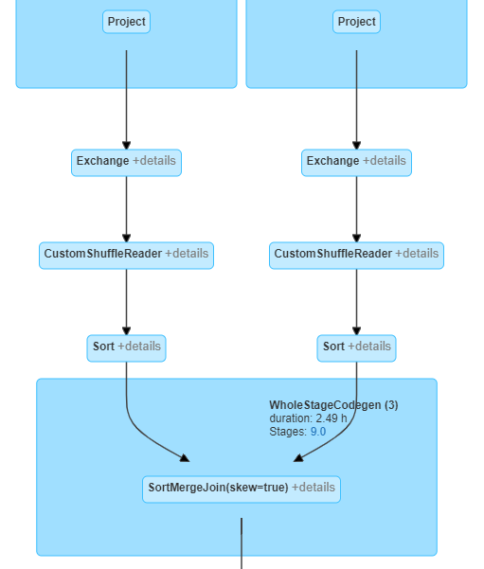
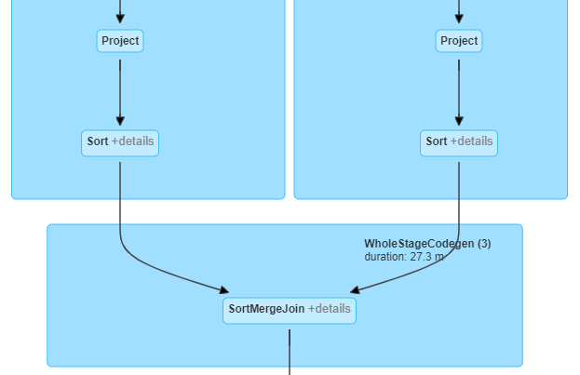
The 5 Most Common Performance Problems (The 5 Ss)
Shuffle - With & without bucketing
See Experiment #6167
and the query for Step B
See Experiment #6167
and the query for Step D
Notes:
Skew: partition-by, bucket by a second column, salt the bucketing column

Slide 4
The 5 Most Common Performance Problems (The 5 Ss)
Shuffle - Bucketing Requirements
To work properly, both tables must have the same number of buckets
You must predetermine the number of buckets
The general rule is one bucket per core
You must predetermined the, initial Spark-Partition size
Upon ingest, one bucket == one spark-partition
Overrides spark.sql.files.maxPartitionBytes … more on maxPartitionBytes later
The labor to produce & maintain is high… subsequently it must be justifiable
Bucketing exposes skew - it should be mitigated during production
Notes:
Skew: partition-by, bucket by a second column, salt the bucketing column

Slide 5
The 5 Most Common Performance Problems (The 5 Ss)
Shuffle - When to Bucket
When does bucketing make sense?
With a 100 GB dataset, I can load all data into two 488 GB, 64 core workers
With only two workers, the cost of shuffling is nearly nonexistent
The sort needs to be slow
And the cost of IO between executors needs to be high (e.g. many workers)
At a 1 to 50 terabyte scales we are already using the largest VMs possible with dozens to scores to hundreds of workers
Notes:
Skew: partition-by, bucket by a second column, salt the bucketing column

